Slide 1
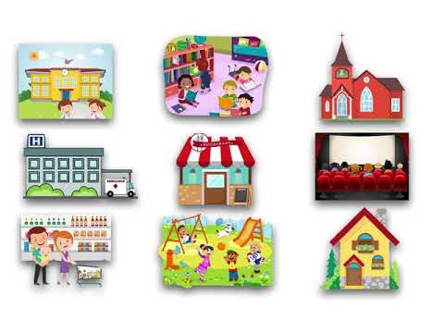
GRADE 4
UNIT 7
Places to go
Lesson 1-3

Slide 3
Listen and point

Slide 4
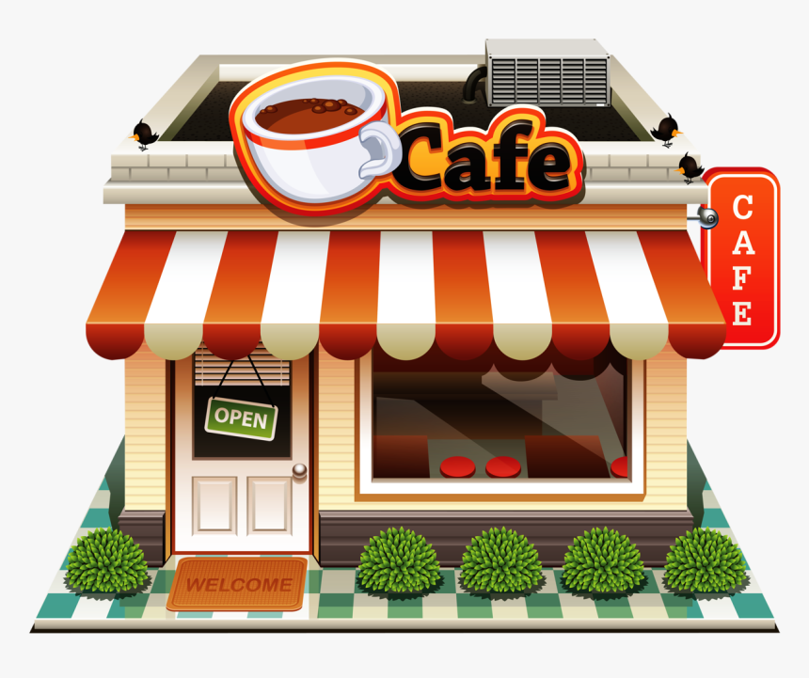
cafe

Slide 5
library

Slide 6
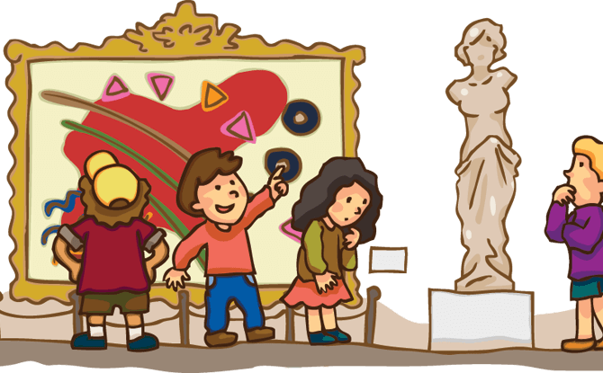
museum

Slide 7
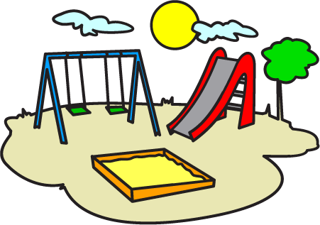
playground

Slide 8
shopping mall

Slide 9
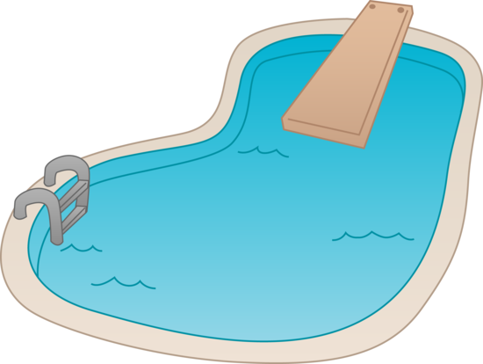
swimming pool

Slide 10
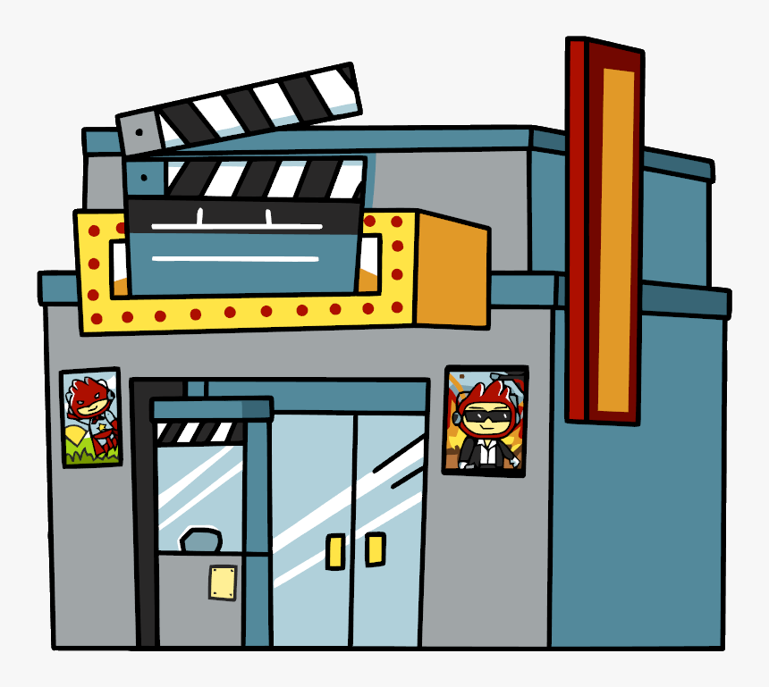
movie theater

Slide 11
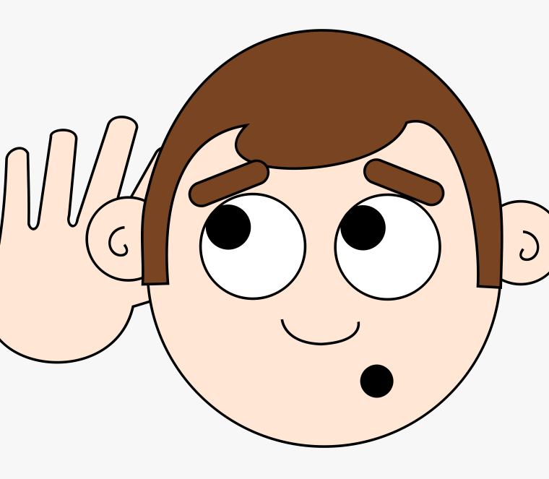
LISTEN and REPEAT

Slide 12
Tasks: Watch the video and answer these questions
Where are they?
What are they doing?

Slide 14
Pair work: answer these questions
Where are they?
What are they doing?

Slide 15
GROUPWORK: Role play

Slide 17
UNIT 7
Places to go
Lesson 2

Slide 19
READ AND CIRCLE
listens to music.

Slide 20
WRITE. on / in / at.
1. Mai's birthday is _in March.
2. I always have lunch ____ one o'clock.
3. Dad never works ____ Saturdays.
4. We sometimes go to the beach ____ August.
5. You never watch TV ____ Mondays.
6. The children always go to bed ___ nine o'clock
at
on
in
on
at

Slide 21
UNIT 7
Places to go
Lesson 3

Slide 22
choose a boy or a girl. Look and say.

Slide 23
Listen and sing

Slide 24
Workbook time!!!

Slide 25
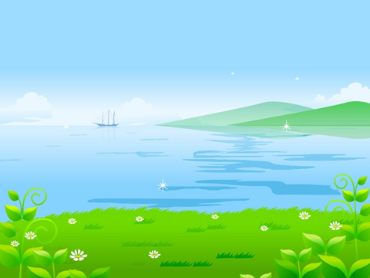
GOODBYE,
SEE YOU AGAIN!

